Slide 1



Laser Array with Imaginary Gauge Field
Site ring
Selected region by pumping
Anti-resonance link ring
$$κ=e^{h}$$
Pumping-induced imaginary gauge field
1:
2:
Similar with 1D, but more flexibilities
$$κ=e^{−h}$$
3:
Decoupling
$κ=$0
Implementing phase array for far field imaging, 3D display, beam forming, etc.
Notes:
We borrow this concept in our laser array design. Because of the potential tunability and flexibility brought by the non-Hermitian engineering, the direction of gauge field and the selected region can be modified by designing a pumping pattern on an active platform. There are three conditions for the couplings.
The right schematic shows the implementation of the imaginary gauge field in a square lattice.
Such tunability induced by the imaginary gauge field in this square lattice is similar with 1D, but with more flexibilities.

Slide 2
Full Flow of the Inverse Design
Near Field
Imaginary gauge field
FFT
FFT
FFT
I. Gerchberg-Saxton Phase Retrieval
II. Nearfield Phase Quantization
III. Phase Modulated by Imaginary Gauge Field

Slide 3
Horizontal bar in the far field
Imaginary gauge field

Slide 4
Illustration of active phase modulation
Yellow dots: main sites with scatters;
Blue dots: auxiliary sites with imaginary gauge field, for phase tuning, without scatters.
…
…

Slide 5
Hologram by ring resonators
Site spacing: 200µm
2.5mm
2.5mm
Desired image plane
Reconstructed image plane
Sample plane

Slide 6
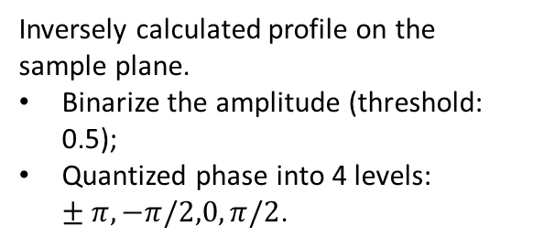
Quantization of field profile on sample plane
Site spacing: 200µm
Inversely calculated profile on the sample plane.
Binarize the amplitude (threshold: 0.5);
Quantized phase into 4 levels: $±π, −π/2,0,π/2$.
2.5mm

Slide 7
Future Plan
Phase tuning logics realized by the imaginary gauge field
Influence of random perturbations/dominant mode.

Slide 8
Minimum 6 by 6 ring resonators
Inverse design
Quantized

Slide 9
Gerchberg-Saxton Phase Retrieval
Site spacing: 20µm
GS loop: 1000 iterations.
100µm
100µm
Desired image plane
Sample plane
Reconstructed image plane
GS algorithm is hard to converge with the Green function.
GS is used for phase retrieval and imaginary gauge field implementation.
If we can implement the hologram with a large site spacing, then the GS is not necessary.

Slide 10
A moving dot hologram in a 3-by-3 square lattice

Slide 11
A moving dot hologram
Sample plane phase
Recovered image
Imaginary gauge field implementation

Slide 12


A moving dot hologram by ring resonators
Near Field
$$200μm$$
$$z=1000μm$$

Slide 13



$$Quantized phase$$
$$z=1000μm$$
$$Finer mesh$$
From the 3 by 3 pixel inverse calculation, we can design the hologram by ring resonators.

